Slide 1

CT-463 DATA WAREHOUSE & MINING
PRESENTATION
Midas Electronics

Slide 2
GROUP MEMBERS
01
02
03
04
05
CT-22016
CT-22019
CT-22020
CT-22021
CT-22049
HIMAYAL ASGHAR JAHAN
MARIA SHAIKH
AYESHA ATIQ
BAZIGHA FAROOQ
SARA RAZEEN

Slide 3
THE BUSINESS PROBLEM
What Problem Are We Solving?
  Data scattered across multiple systems
  No unified view of performance
  Manual reporting taking hours
  20 percent return rate with no prediction model
  No competitor intelligence
The Impact
  Unable to identify valuable customers
  Missing key revenue opportunities
  Decisions remain reactve instead of data-driven

Slide 4
OUR SOLUTION
Centralized Data Warehouse — One System. Complete Intelligence.
What We Built
  Unified database bringing all data into one place
  Star schema design for fast and efficient analytics
  Machine learning models to predict returns and segment customers
  Live dashboards providing real-time business insights
The Result
500 transactions | $418K revenue | 3 data sources | 9 optimized tables

Slide 5
PROJECT OBJECTIVES
  Centralize Data
    Integrate OLTP systems, APIs, and files into a unified data warehouse
  Optimize Performance
    Implement a Star Schema design for sub-second query response
  Ensure Quality
    Maintain 100% referential integrity with zero null values
  Enable Analytics
    Support OLAP operations such as drill-down, roll-up, slice, dice, and pivot
  Apply Machine Learning
    Use ML for customer segmentation, return prediction, and anomaly detection
  Deliver Insights
    Create executive dashboards with actionable KPIs for real-time decision-making

Slide 6
DATA SOURCES
01
OLTP System (Excel Files)
  6 dimension tables
  500 sales transactions
  Includes customer, product, date, and channel data
02
External APIs
  Competitor pricing
  Marketing data (Google Ads, Facebook, Email)
  Customer reviews and sentiment scores
03
Data Warehouse
  SQLite database
  9 total tables
  Fully optimized for analytical processing

Slide 7
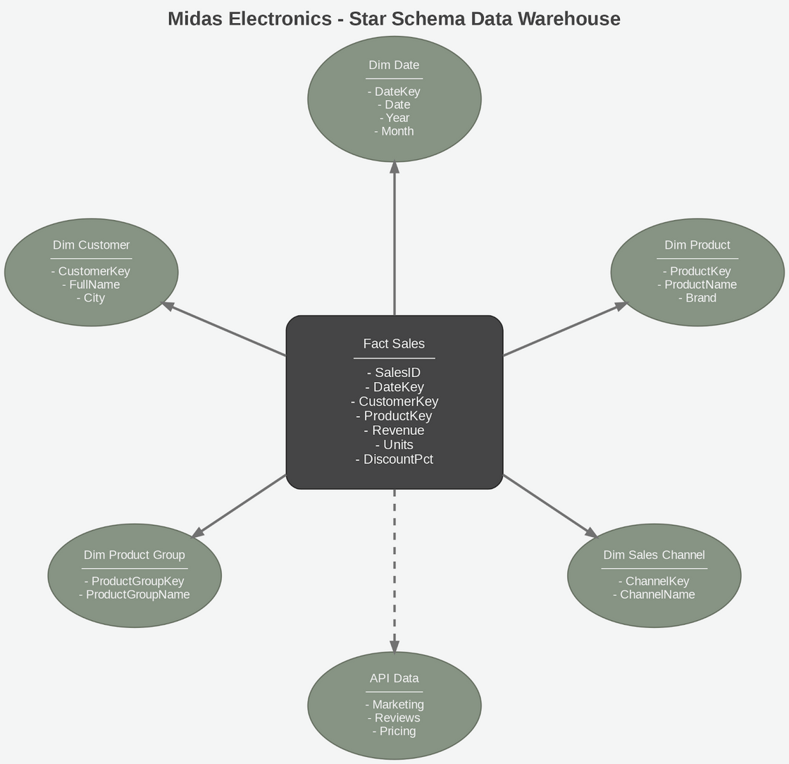
STAR SCHEMA ARCHITECTURE

Slide 8
WHY STAR SCHEMA?
Performance
  Denormalized design enables fast aggregations
  Sub-second query response times
BI Tool Ready
  Integrates with Power BI, Tableau, and Python
  Enables one-click dashboard creation
01
03
Business Friendly
  Mirrors real business logic
  Easy for non-technical users to understand
Scalable
  Add new dimensions without restructuring
  Adapts easily to growing business needs
02
04

Slide 9

ETL PIPELINE
Extract → Transform → Load
We collected data from multiple sources, including 6 Excel files from Google Drive and 3 simulated API sources.
A total of 500 transactions were successfully loaded and verified for accuracy.
During transformation, we found 40 missing customers and 79 missing dates.
“Unknown” placeholders were added to maintain data integrity, achieving 100% referential integrity.
A SQLite warehouse database was created, and 9 validated tables were loaded.
The final warehouse was saved to Google Drive for persistence.
Extract
Transform
Load

Slide 10
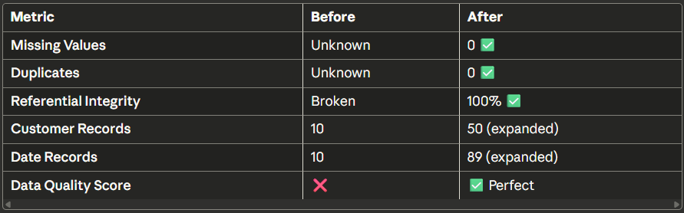
DATA QUALITY RESULTS
Before vs After
Quality Rules Applied
  No nulls allowed
  No duplicates
  All foreign keys validated
  Business logic checks (revenue > 0, discount 0-100%)

Slide 11
OLAP OPERATIONS
01
Drill-Down (Year → Month → Day)
We examined data at progressively detailed levels. March emerged as the best month, generating $149,903—12% higher than January.
03
Slice (Filter one dimension)
Focusing on a single dimension, field sales contributed 61.5% of total revenue.
02
Roll-Up (Product → Brand → Category)
Aggregating sales from product to brand level showed that MidasHome leads with $132,885, accounting for 32% of total revenue.
04
Dice (Multi-filter)
Applying multiple filters—MidasPro, January, and Field sales—revealed that the LED TV 55" was the top performer.
05
Pivot (Cross-tabulation)
A pivot table (heatmap) comparing month vs. brand revenue highlights trends and patterns across the dataset.

Slide 12
KEY BUSINESS INSIGHTS
What The Data Tells Us
The Washing Machine 7kg led sales at $42,917. Field sales accounted for 61.5% of revenue, making it a critical channel, while Kitchen Appliances topped the category with $149K.
MidasHome is growing steadily. Budget shoppers are 26% of customers perfect for loyalty programs.
Email marketing shows a 790% ROI, highlighting expansion potential.
March outperformed other months by 12%, revealing a clear seasonal pattern.
Q1-end promotions proved to be highly successful.
Revenue Trends
Top Performance
Opportunities

Slide 13
MACHINE LEARNING OVERVIEW
01
Customer Segmentation
  K-Means Clustering
  Identified 3 distinct customer groups
02
Return Prediction
  Random Forest Classifier
  76% accuracy predicting returns
03
Anomaly Detection
  Isolation Forest
  5% of transactions flagged as unusual

Slide 14
BUSINESS INTELLIGENCE DASHBOARDS
Report generation time reduced from hours to minutes
01
Executive Summary
Highlights KPIs, revenue trends, top products, and key sales channels.
02
Sales Performance
Includes day-of-week analysis, discount impact, and customer ranking insights.
03
ML Performance
Shows model accuracy, segmentation visuals, and predictions.

Slide 15
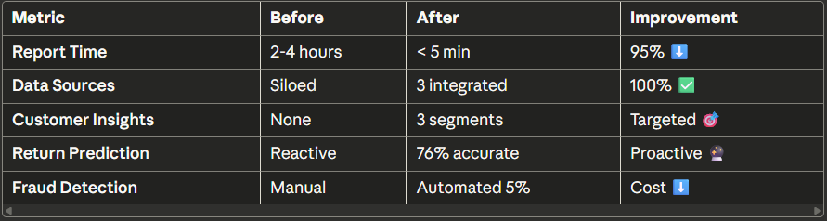
MEASURABLE BENEFITS
Before vs After Implementation

Slide 16
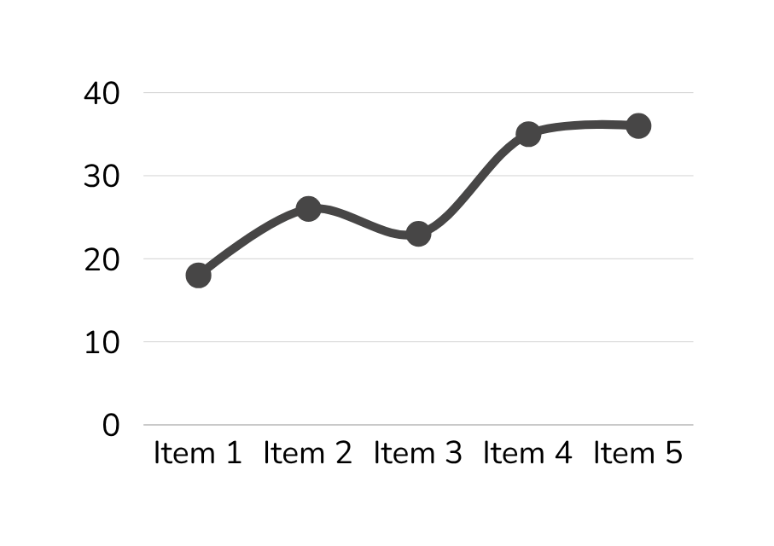
BUSINESS IMPACT
Revenue Optimization
  Replicate March success with a 12% boost
  Focus on field sales, the 61.5% revenue driver
  Leverage MidasHome brand strength

Slide 17
BUSINESS IMPACT
Marketing Efficiency
  Target 3 key customer segments
  Email campaigns delivering 790% ROI
  Reduce wasted ad spend

Slide 18
BUSINESS IMPACT
Inventory Management
  Stock top 5 products
  Reduce high-return items
  Predict demand by channel

Slide 19
BUSINESS IMPACT
Risk Reduction
  Predict 76% of returns early
  Automatically flag 5% of anomalies
  Enable proactive quality control

Slide 20
CONCLUSION
  Built a complete data warehouse solution for Midas Electronics.
  Integrated multiple data sources into a centralized Star Schema database.
  Implemented advanced analytics using OLAP operations and machine learning.
  Delivered actionable business insights through automated dashboards.
  Enabled faster, smarter, data-driven decision-making.
  Achieved 76% return prediction accuracy.
  Provided clear customer segmentation.
  Enabled real-time performance monitoring.

Slide 21
THANK YOU

